Slide 1
Bike Counter

Slide 2
Data from NYCDOT Data Bike Counter

Slide 3
All imports for notebook contained in the below cell.

Slide 4
In [25]:
import pandas as pd import numpy as np import os
import glob
pd.options.display.max_rows = 400
import matplotlib.pyplot as plt
import seaborn as sns; sns.set(style="white", color_codes=True)

Slide 5
Creates a list of hles to be used in for loop

Slide 6
In [26]:
files = ['https://raw.githubusercontent.com/aaarista/Website/master/NYCDOT_20Bicyc le_20Counts_20-_20East_20River_20Bridges/04%20April%202016%20Cyclist%20Numbers%20f or%20Web.csv', 'https://raw.githubusercontent.com/aaarista/Website/master/NYCDOT_2 0Bicycle_20Counts_20-_20East_20River_20Bridges/05%20May%202016%20Cyclist%20Numbers
%20for%20Web.csv',
'https://raw.githubusercontent.com/aaarista/Website/master/NYCDOT_20Bicycl e_20Counts_20-_20East_20River_20Bridges/06%20June%202016%20Cyclist%20Numbers%20fo r%20Web.csv', 'https://raw.githubusercontent.com/aaarista/Website/master/NYCDOT_20 Bicycle_20Counts_20-_20East_20River_20Bridges/07%20July%202016%20Cyclist%20Numbers
%20for%20Web.csv',
'https://raw.githubusercontent.com/aaarista/Website/master/NYCDOT_20Bicycl e_20Counts_20-_20East_20River_20Bridges/08%20August%202016%20Cyclist%20Numbers%20f or%20Web.csv',
'https://raw.githubusercontent.com/aaarista/Website/master/NYCDOT_20Bicycl
e_20Counts_20-_20East_20River_20Bridges/09%20September%202016%20Cyclist%20Numbers% 20for%20Web.csv', 'https://raw.githubusercontent.com/aaarista/Website/master/NYCDO T_20Bicycle_20Counts_20-_20East_20River_20Bridges/10%20October%202016%20Cyclist%20 Numbers%20for%20Web.csv']

Slide 7
Creates empty dataframe and for loop to parse and read data from each hle as well as concatenate to one dataframe for further manipulation.
In [27]:
all_data = pd.DataFrame()
for f in glob.glob("/Users/macbookair/NYCDOT_20Bicycle_20Counts_20-_20East_20River_20Bridges/*"):
dateparse = lambda x: pd.datetime.strptime(x, '%m-%d %M:%S') df = pd.read_csv(f, error_bad_lines=False, thousands=',') all_data = all_data.append(df,ignore_index=True, sort=True)

Slide 8
In [29]:
all_data.shape
Out[29]:
(320, 14)

Slide 9
Transforms the 'Date' column to datetime format

Slide 10
In [30]:
all_data['Date'] = pd.to_datetime(all_data['Date'], format = "%m/%d")

Slide 11
Sets the dataframe to the columns that will be used.

Slide 12
In [31]:
all_data = all_data[['Date', 'Brooklyn Bridge','Day', 'High Temp (°F)', 'Low Temp (°F)', 'Manhattan Bridge', 'Williamsburg Bridge', 'Precipitation', 'Queensboro Br idge', 'Total']]

Slide 13
Repair the Date column year to 2016
There was no year given in the initial datasource. The default was 1900 which makes the data unclear. The correct year of the datasource is 2016. The following codes achieves this task:

Slide 14
In [32]:
all_data['Date'] = all_data['Date'].mask(all_data['Date'].dt.year == 1900,
all_data['Date'] + pd.offsets.DateOffset(year=2016))
all_data.head()
 | Date | Brooklyn Bridge | Day | High Temp (°F) | Low Temp (°F) | Manhattan Bridge | Williamsburg Bridge | Pre
0 | 2016- 09-01 | 1608.0 | Thursday | 78.1 | 70.0 | 3012.0 | 4435.0 | T
1 | 2016- 09-02 | 3594.0 | Friday | 80.1 | 66.0 | 6657.0 | 7116.0 | 0.0
2 | 2016- 09-03 | 2850.0 | Saturday | 73.9 | 68.0 | 7357.0 | 5115.0 | 0.0
3 | 2016- 09-04 | 2871.0 | Sunday | 79.0 | 64.9 | 6949.0 | 4800.0 | 0.0
4 | 2016- 09-05 | 2465.0 | Monday | 82.9 | 66.0 | 6248.0 | 4904.0 | 0.0

Slide 16
Set index to date
In [33]:
all_data.index = all_data['Date']
del all_data['Date']

Slide 17
Drops all rows that have Nan value in 'Total' column.

Slide 18
In [34]:
all_data.dropna(subset=['Total'], inplace=True)

Slide 19
To make the data more user-friendly the 'Date' column will be sorted ascending from the earliest date.

Slide 20
In [35]:
all_data.sort_values(by='Date').head()
Out[35]:
 | Brooklyn Bridge | Day | High Temp (°F) | Low Temp (°F) | Manhattan Bridge | Williamsburg Bridge | Precipit
Date
2016- 04-01 | 1704.0 | Friday | 78.1 | 66.0 | 3126.0 | 4115.0 | 0.01
2016- 04-02 | 827.0 | Saturday | 55.0 | 48.9 | 1646.0 | 2565.0 | 0.15
2016- 04-03 | 526.0 | Sunday | 39.9 | 34.0 | 1232.0 | 1695.0 | 0.09
2016- 04-04 | 521.0 | Monday | 44.1 | 33.1 | 1067.0 | 1440.0 | 0.47 (S)
2016- 04-05 | 1416.0 | Tuesday | 42.1 | 26.1 | 2617.0 | 3081.0 | 0.00

Slide 21
In [36]:
all_data['Precipitation'] = all_data['Precipitation'].replace("T", 0) all_data['Precipitation'] = all_data['Precipitation'].replace("0.47 (S)", 0.47)

Slide 22
In [37]:
all_data['Precipitation'] = all_data['Precipitation'].convert_objects(convert_nume ric=True)
/anaconda3/lib/python3.6/site-packages/ipykernel_launcher.py:1: FutureWarning: convert_objects is deprecated. To re-infer data dtypes for object columns, us e Series.infer_objects()
For all other conversions use the data-type specific converters pd.to_datetim
e, pd.to_timedelta and pd.to_numeric.
"""Entry point for launching an IPython kernel.

Slide 23
Change datatype to float
In [38]:
all_data[['Manhattan Bridge', 'Williamsburg Bridge', 'Queensboro Bridge']].astype( float).head()
Out[38]:
 | Manhattan Bridge | Williamsburg Bridge | Queensboro Bridge
Date
2016-09-01 | 3012.0 | 4435.0 | 3498.0
2016-09-02 | 6657.0 | 7116.0 | 5376.0
2016-09-03 | 7357.0 | 5115.0 | 3961.0
2016-09-04 | 6949.0 | 4800.0 | 3275.0
2016-09-05 | 6248.0 | 4904.0 | 3583.0

Slide 24
In [39]:
all_data.dtypes
Out[39]:
Brooklyn Bridge Day
High Temp (°F)
Low Temp (°F) Manhattan Bridge Williamsburg Bridge Precipitation Queensboro Bridge Total
dtype: object
float64 object float64 float64 float64 float64 float64 float64 float64

Slide 25
***The data is now tranformed correctly so that analysis can be done.

Slide 26
Data Grouping and Preliminary Analysis

Slide 27
Verify the correct number of days for each month

Slide 28
In [40]:
all_data.resample('M').size()
Out[40]:
Date
2016-04-30 | 30
2016-05-31 | 31
2016-06-30 | 30
2016-07-31 | 31
2016-08-31 | 31
2016-09-30 | 30
2016-10-31 | 31
Freq: M, dtype: int64

Slide 29
Basic statistical description of 'all data' dataframe.

Slide 30
In [41]:
all_data.describe().round()
Out[41]:
 | Brooklyn Bridge | High Temp (°F) | Low Temp (°F) | Manhattan Bridge | Williamsburg Bridge | Precipitation | Qu
count | 214.0 | 214.0 | 214.0 | 214.0 | 214.0 | 214.0 | 21
mean | 3031.0 | 75.0 | 62.0 | 5052.0 | 6161.0 | 0.0 | 43
std | 1134.0 | 13.0 | 12.0 | 1745.0 | 1911.0 | 0.0 | 12
min | 504.0 | 40.0 | 26.0 | 997.0 | 1440.0 | 0.0 | 13
25% | 2388.0 | 66.0 | 53.0 | 3713.0 | 4884.0 | 0.0 | 34
50% | 3076.0 | 78.0 | 65.0 | 5132.0 | 6334.0 | 0.0 | 43
75% | 3685.0 | 85.0 | 71.0 | 6610.0 | 7858.0 | 0.0 | 53
max | 8264.0 | 96.0 | 82.0 | 9152.0 | 9148.0 | 2.0 | 63
4
0
6
0
9
4
0
9

Slide 31
Charts

Slide 32
Total pedestrian cyclists aggregated by month

Slide 33
In [42]:
ttl_month = all_data[['Manhattan Bridge', 'Williamsburg Bridge', 'Queensboro Bridg e']].resample('M').sum().round()
ax1 = ttl_month.plot(kind='bar', title ="Total by Month", figsize=(15, 10), legend=True, fontsize=12)
ax1.set_xticklabels(['Apr', 'May', 'June', 'July', 'Aug', 'Sep', 'Oct'])
Out[42]:
[Text(0,0,'Apr'),
Text(0,0,'May'),
Text(0,0,'June'),
Text(0,0,'July'),
Text(0,0,'Aug'),
Text(0,0,'Sep'),
Text(0,0,'Oct')]

Slide 34
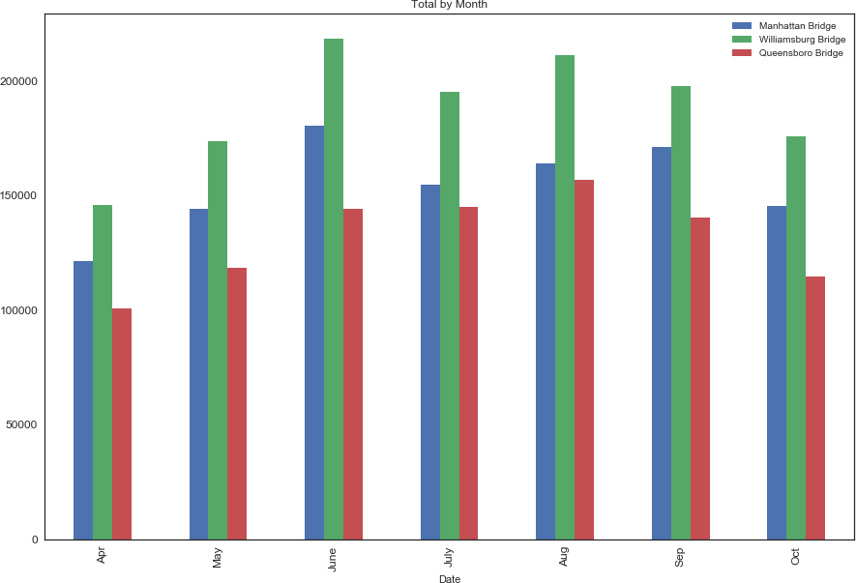

Slide 35
Median monthly pedestrian cyclists

Slide 36
In [43]:
med_month = all_data[['Manhattan Bridge', 'Williamsburg Bridge', 'Queensboro Bridg e']].resample('M').median().round()
ax2 = med_month.plot(kind='bar', title ="Median by Month", figsize=(15, 10), legend=True, fontsize=12)
ax2.set_xticklabels(['Apr', 'May', 'June', 'July', 'Aug', 'Sep', 'Oct'])
Out[43]:
[Text(0,0,'Apr'),
Text(0,0,'May'),
Text(0,0,'June'),
Text(0,0,'July'),
Text(0,0,'Aug'),
Text(0,0,'Sep'),
Text(0,0,'Oct')]

Slide 37
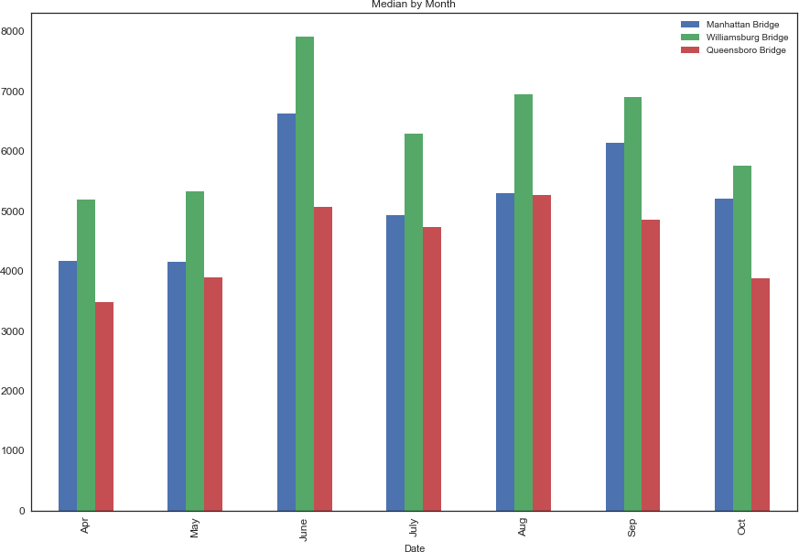

Slide 38
Mean pedestrian cyclists by month

Slide 39
mean_month = all_data[['Manhattan Bridge', 'Williamsburg Bridge', 'Queensboro Brid ge']].resample('M').mean().round()
ax3 = mean_month.plot(kind='bar', title ="Mean by Month", figsize=(15, 10), legend=True, fontsize=12)
ax3.set_xticklabels(['Apr', 'May', 'June', 'July', 'Aug', 'Sep', 'Oct'])
Out[44]:
[Text(0,0,'Apr'),
Text(0,0,'May'),
Text(0,0,'June'),
Text(0,0,'July'),
Text(0,0,'Aug'),
Text(0,0,'Sep'),
Text(0,0,'Oct')]

Slide 40
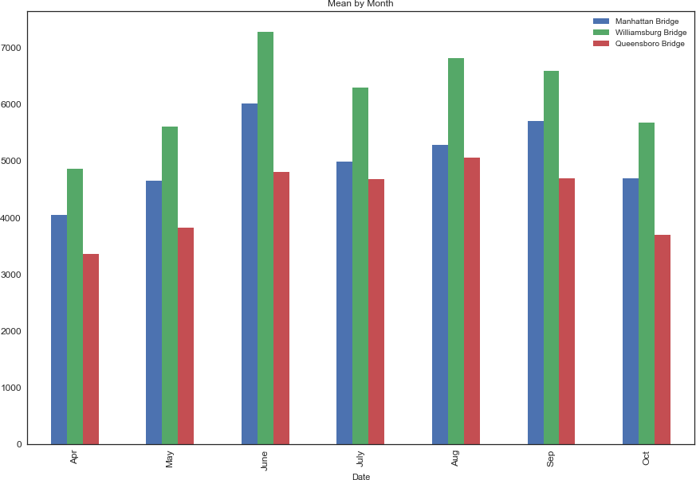

Slide 41
Seaborn pairplot to show temperature and precipitation impact on cyclists
pp = sns.pairplot(all_data, hue='Day') sns.set(font_scale=1.5)

Slide 42
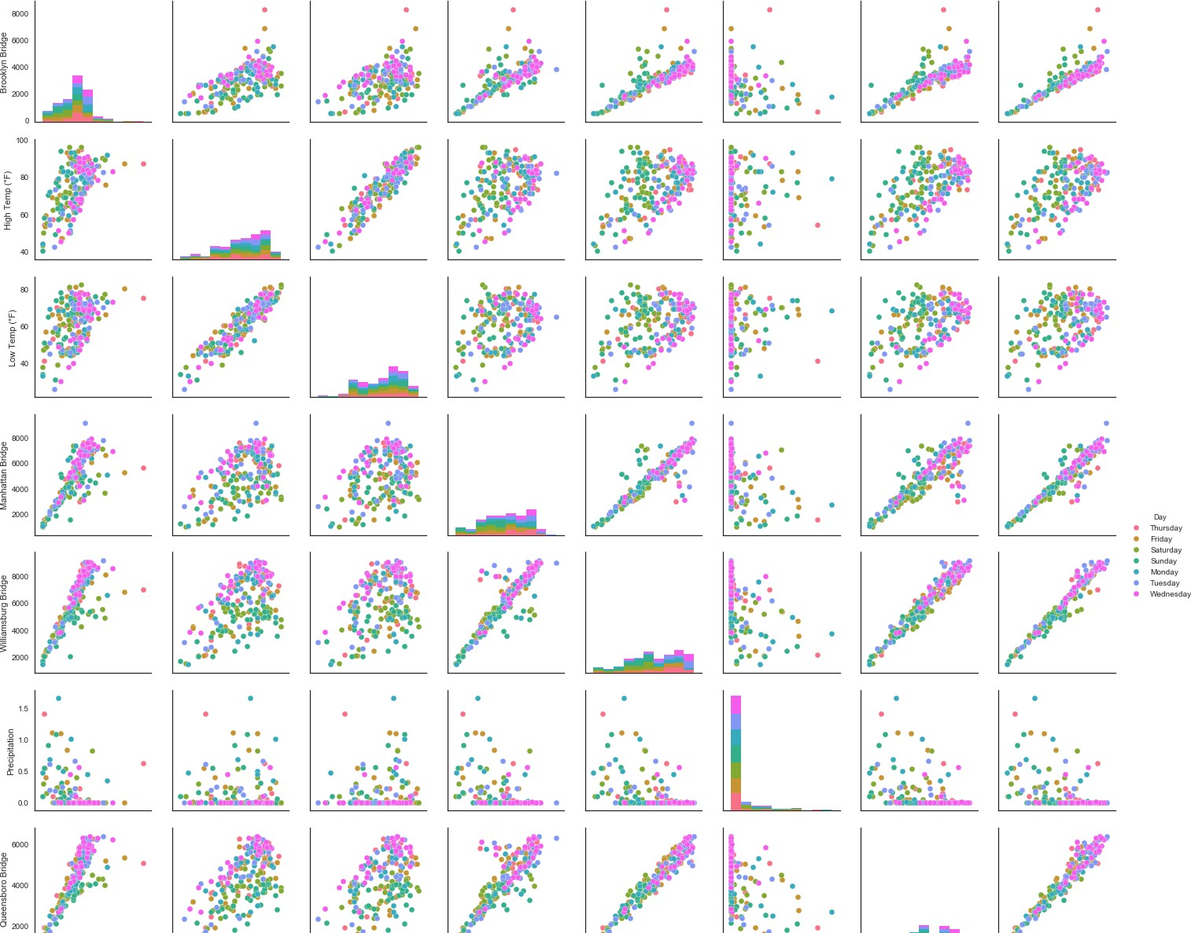
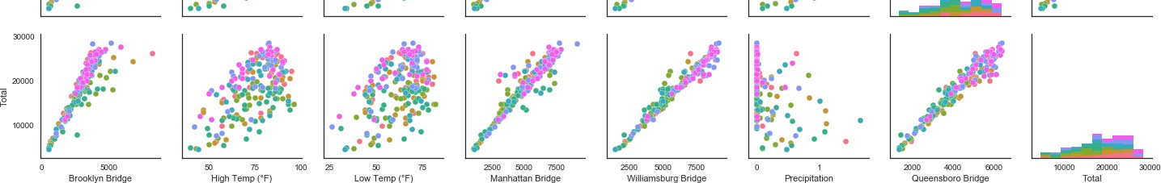

Slide 43
Time Series Analysis

Slide 44
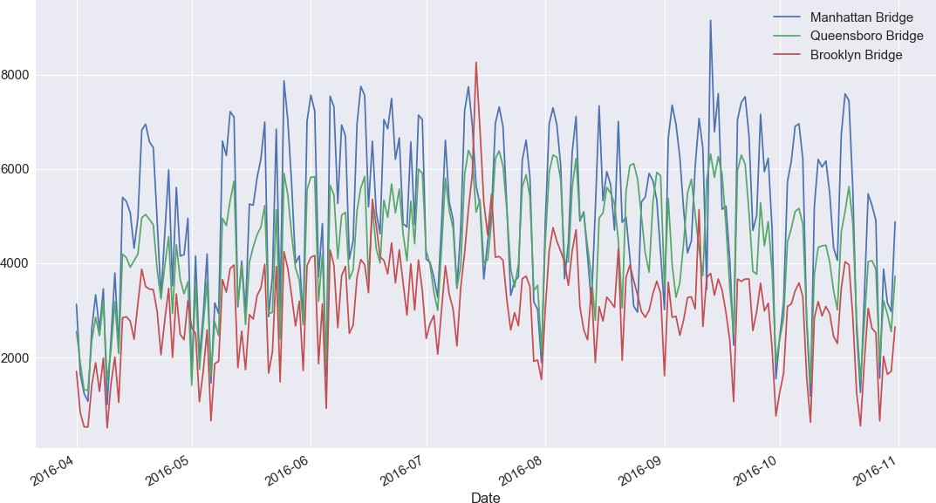
In [46]:
grp_line = all_data[['Manhattan Bridge', 'Queensboro Bridge', 'Brooklyn Bridge']] pp = grp_line.plot()
fig = plt.gcf()
fig.set_size_inches(18.5, 10.5)

